Slide 1

Predicting BA Customer buying behaviour
Predictive model to understand factors that influence buying behaviour

Slide 2
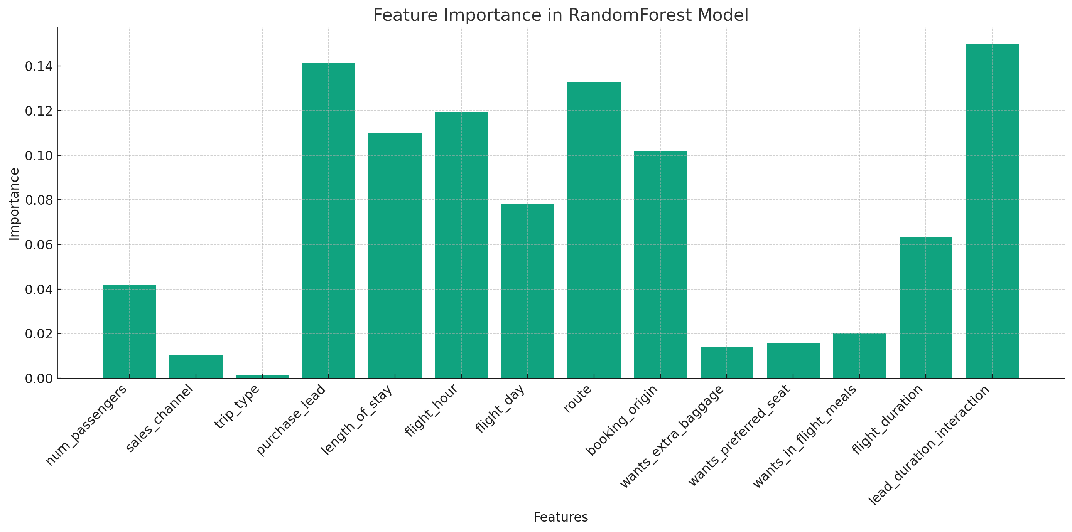
RESULTS
Most Important Features:
purchase_lead: Lead time for purchase.
flight_hour: Hour of the flight.
length_of_stay: Duration of stay.
lead_duration_interaction: The interaction feature we created combining purchase lead time and flight duration.
Least Important Features:
wants_preferred_seat: Whether the passenger wants a preferred seat.
sales_channel: Channel through which booking was made.
From this, we can infer that factors such as the lead time for purchase, flight hour, and the length of stay are significant predictors in determining if a customer will complete a booking.

